Slide 1


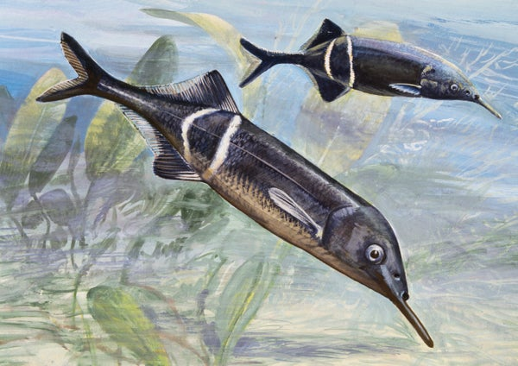
Computerized System for Studying Escape Behavior in Electric Fish
Students: Michal Shani
Supervisor: Avner Wallach

Slide 2
Outline
Project Goal
Background
Literature Review
Referenced Studies
System Overview
LED System
Next steps

Slide 3
Project Goals
Main Goal: Building a system that enables the study of how Peters' elephantnose fish respond to stimuli
Objectives:
Develop system components that generate visual and auditory stimuli
Lay the groundwork for future behavioral experiments
Provide a flexible and programmable setup for studying behavior in real-time

Slide 4
Background
Escape behavior in fish is a rapid and complex response to threatening stimuli, involving precise sensory-motor coordination
Behavioral experiments on aquatic animals as such often rely on manual stimuli and uncontrolled environments.
An automated system will allow:
Precise delivery of visual and auditory stimuli
Synchronized event timing (lighting, sound, gating)
Real-time interaction with animal behavior
Notes:
The goal is to bridge the gap between behavior research and accessible, programmable experimental platforms. Designing such systems requires:
Reliable hardware in underwater or humid conditions
Modular codebases for flexible stimulus control
Low-latency responses to external triggers (e.g., cameras, sensors)

Slide 5
Literature Review: Existing Experimental Systems
Most setups were either observational or manually triggered
Few studies implemented real-time control of multiple stimulus types (light/sound/motion)
No known system offered a flexible, open-source hardware/software platform for behavioral control (e.g. - modular, Arduino-based automation)
Notes:
Systems are often not responsive to the fish's real-time behavior
This project aims to address these gaps by developing a fully programmable, multi-modal stimulus system tailored for real-time behavioral studies in aquatic environments

Slide 6
Referenced Studies
Cognitive Control of Escape Behaviour Dominic A. Evans, A. Vanessa Stempel, Ruben Vale and Tiago Branco
Escape responses of fish: a review of the diversity in motor control, kinematics and behaviour Paolo Domenici and Melina E. Hale
Long-term Behavioral Tracking of Freely Swimming Weakly Electric Fish James J. Jun, André Longtin, Leonard Maler, Department of Physics - University of Ottawa, Department of Cellular and Molecular Medicine - University of Ottawa, Centre for Neural Dynamics - University of Ottawa
Kinematics and Behaviour in Fish Escape Responses: Guidelines for Conducting, Analysing, and Reporting Experiments Paolo Domenici et al.
Landmark Use and Development of Navigation Behaviour in the Weakly Electric Fish Gnathonemus petersii Peter Cain, Sapna Malwal
Finding Food: Senses Involved in Foraging for Insect Larvae in the Electric Fish Gnathonemus petersii Gerhard von der Emde, Horst Bleckmann

Slide 7
Cognitive Control of Escape Behaviour
Studied escape behavior in mice using looming visual stimuli to simulate aerial predators
Visual threats were presented from above, using a standard looming-stimulus setup (e.g., expanding black circles)
Animal behavior was tracked in real-time
Combined with neural recordings and optogenetic manipulation to study cognitive control during threat response

Slide 8
Escape responses of fish: a review of the diversity in motor control, kinematics and behaviour
Common methods included mechanical taps, water jets, and visual stimuli
Behavioral data collected using high-speed video tracking (500–1000 fps)
Arena sizes and stimulus types were adapted to each fish species
Notes:
Animal models: Various fish species (e.g., zebrafish, goldfish, trout)
Review article summarizing experimental approaches to studying fish escape responses
Emphasized diversity in kinematics and neural control across fish

Slide 9
Long-term Behavioral Tracking of Freely Swimming Weakly Electric Fish
Built a large shallow tank within a sensory isolation chamber
Used infrared video tracking and electrode arrays to monitor electric organ discharges (EODs)
Motorized gates-controlled access between fish compartments and the central arena
All systems were synchronized to enable long-term tracking of posture, movement, and EOD patterns
Used custom MATLAB software for automated tracking and signal analysis
Notes:
Animal model: Pulse-type weakly electric fish

Slide 10
Kinematics and Behaviour in Fish Escape Responses: Guidelines for Conducting, Analysing, and Reporting Experiments
Methodological review article offering guidelines for escape response experiments
No original experimental system was built in this study
Notes:
Animal model: General fish (no new experimental subjects used)
Describes best practices for stimulus types (visual, acoustic, mechanical)
Recommends arena design, lighting, and high-speed video capture
Provides criteria for analyzing latency, directionality, and trajectory of escape responses

Slide 11
Landmark Use and Development of Navigation Behaviour in the Weakly Electric Fish Gnathonemus petersii
Used a divided aquarium with a circular aperture in a clear wall
Fish were trained to find the aperture with or without plastic landmarks placed nearby
Conducted in a dark room with red lighting to minimize visual interference
Behavior was video recorded and analyzed based on time to cross, height of wall contact, and path
Landmark size and water level were varied to test orientation strategies
Notes:
Animal model: Gnathonemus petersii (weakly electric fish)
Used a divided aquarium with a circular aperture in a clear wall
Fish were trained to find the aperture with or without plastic landmarks placed nearby
Conducted in a dark room with red lighting to minimize visual interference
Behavior was video recorded and analyzed based on time to cross, height of wall contact, and path
Landmark size and water level were varied to test orientation strategies

Slide 12
Finding Food: Senses Involved in Foraging for Insect Larvae in the Electric Fish Gnathonemus petersii
Conducted experiments in a controlled aquarium environment with visual barriers to isolate senses
Tested prey detection under different conditions: visual only, electrical only, combined, and sensory-deprived
Prey (e.g., insect larvae) was placed in small compartments or buried in sand
Behavioral responses (searching, location accuracy) were observed and recorded
Found that electrolocation was highly effective, especially when other senses were blocked
Notes:
Animal model: Gnathonemus petersii (weakly electric fish)
Investigated how electric fish use multiple sensory modalities (electric, visual, mechanical, and olfactory) to locate prey
Conducted experiments in a controlled aquarium environment with visual barriers to isolate senses
Tested prey detection under different conditions: visual only, electrical only, combined, and sensory-deprived
Prey (e.g., insect larvae) was placed in small compartments or buried in sand
Behavioral responses (searching, location accuracy) were observed and recorded
Found that electrolocation was highly effective, especially when other senses were blocked

Slide 13





System Overview
LED Lighting Grid
Camera Tracking
Motorized Gate & Feeding Mechanism
Underwater Speakers
Control Architecture
Notes:
LED Lighting Grid
12 vertical strips × 118 individually controlled WS2812B LEDs
Controlled via Arduino UNO + FastLED
Supports dynamic visual patterns (e.g., expanding dot, text)
Core functionality working; optimization ongoing
Cameras
Enables real-time behavioral monitoring
Output from Bonsai will be used to trigger events in our system
Gate & Feeding Mechanism
Mechanically 3D printed and assembled
Not yet integrated with control system
Control Architecture
Stimuli controlled by Arduino UNO
Central coordination and dataflow via Bonsai software
Designed to interface with Arduino
Will manage timing, triggers, and (eventually) camera input

Slide 14
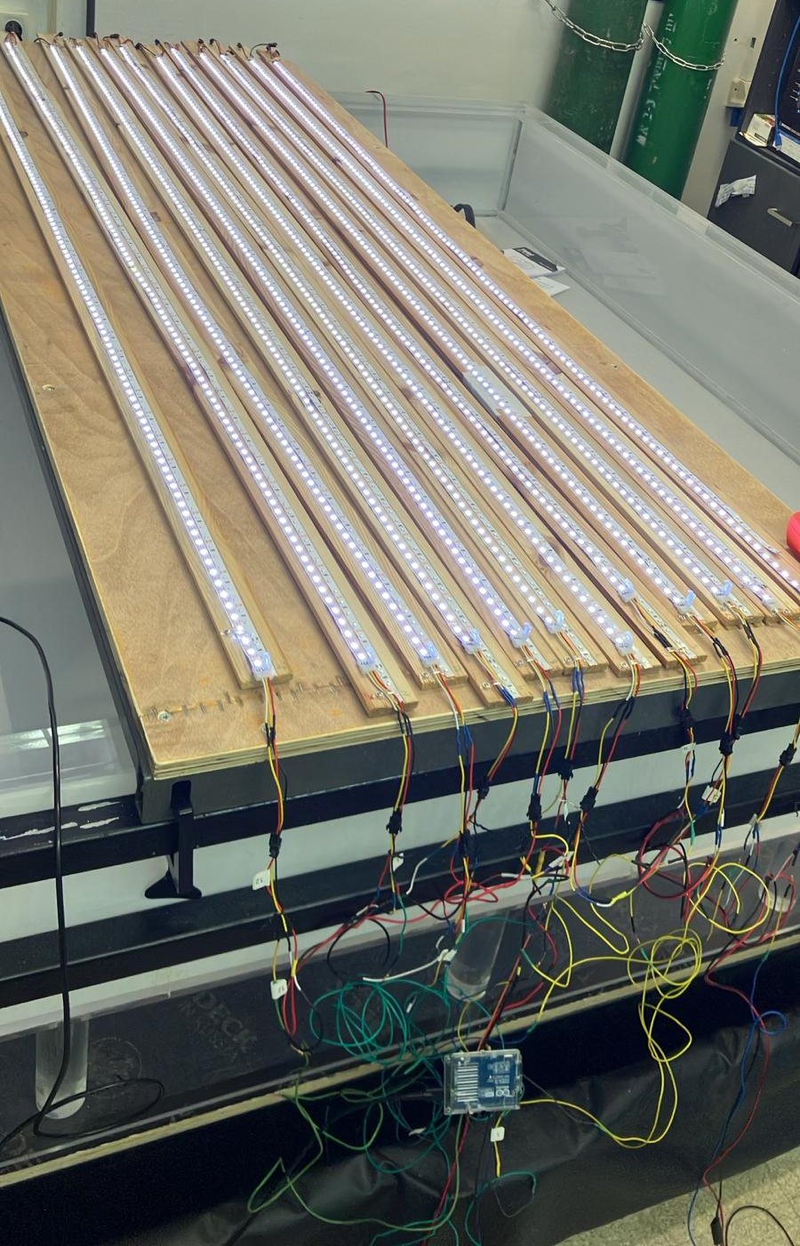
LED System: Implementation & Features
Hardware Setup
12 vertical strips - Each strip contains 118 WS2812B LEDs
Installed and wired into a grid layout (12 columns × 118 rows)
Powered through a custom wiring system for current distribution
Controlled by an Arduino UNO
Functionality Implemented
Grid indexing system using (row, col) coordinates
Multiple lighting patterns
Adjustable brightness and delay control between lighting events
Code structured to support future Bonsai integration

Slide 15
LED System: Challenges & Considerations
Power & Brightness
Full brightness leads to inconsistent color output (yellowing)
System runs reliably only at moderate brightness
Performance Issues
Some patterns are slower than desired for simulating realistic predator approach
Visibility Problems
Patterns are not clearly visible inside the tank
Possibly due to LED distance from glass or low light intensity
System Integration
Bonsai-Arduino communication still in progress
Serial triggers and synchronization need to be finalized
Naturalism & Layout
LEDs currently positioned beneath the tank, which may not mimic natural stimulus sources
May require redesign for more ecologically valid stimuli
May need optimization to create more dynamic, naturalistic stimuli
Notes:
He patterns also were not testes with water in the tank so visibility might be worst

Slide 16
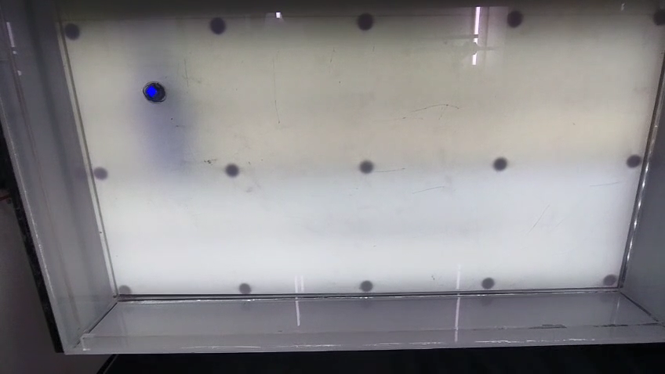
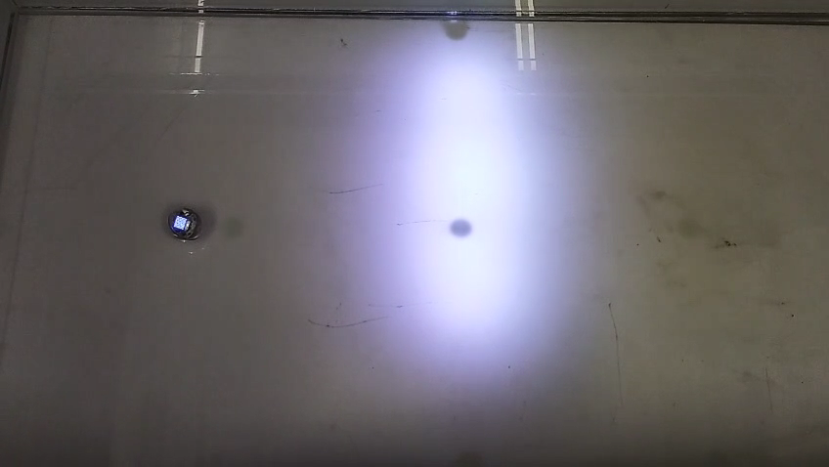
Demo: LED System in Action

Slide 17
Next steps
System Integration
Establish real-time communication between Bonsai and Arduino
Trigger LED patterns based on camera-detected behavior
LED Optimization
Fine-tune animation speeds
Testing & Iteration
Run in-tank trials to assess visibility and behavioral impact
Upcoming Additions
Begin integrating the motorized gate and feeding mechanism
Prepare system for full trial runs with all components
Change wiring to improve power supply
Explore adjustments to light layout or angle
Notes:
Led: Consider an alternative solution (using a projector) Testing: at list test with water

Slide 18
Thank you for listening! Questions?
Notes:
Led: Consider an alternative solution (using a projector) Testing: at list test with water

